Slide 1
Windows Driver Basics
Basic concepts about drivers in the Windows operating system.

Slide 2
Windows Driver Basics
PART I
The Driver Object
Device Objects
Tracing (WinObj, WinDBG)
PART II
Driver Example

Slide 3
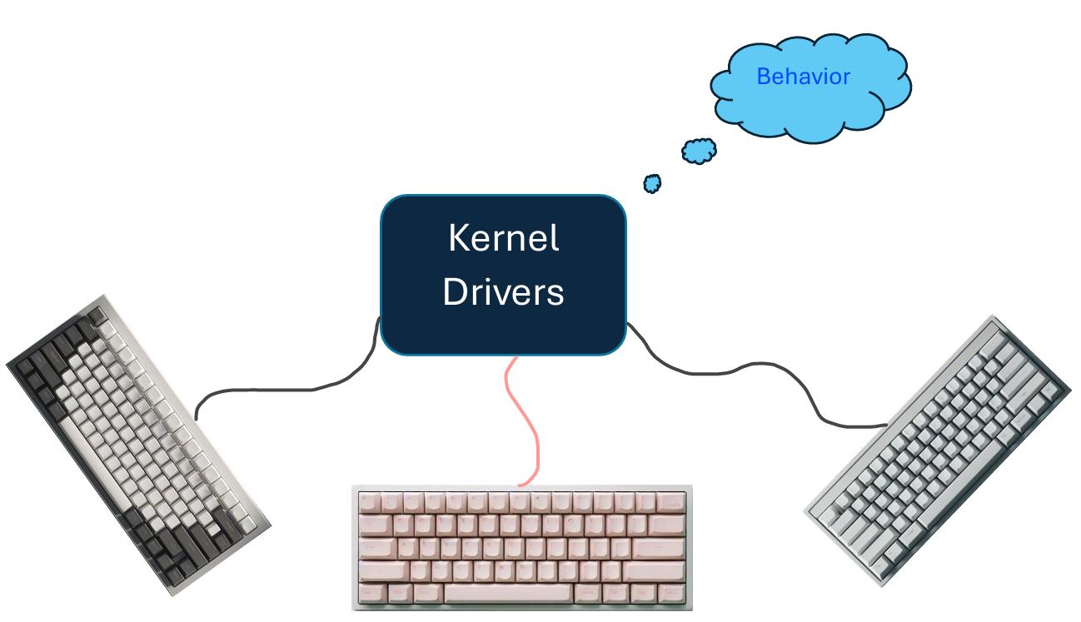
The Driver Object
Represents the image of a loaded kernel-mode driver.
Multiple devices can be handle by One Driver
Major function
IRP_MJ_CREATE (0)
IRP_MJ_CLOSE (2)
IRP_MJ_READ (3)
IRP_MJ_WRITE (4)

Slide 4
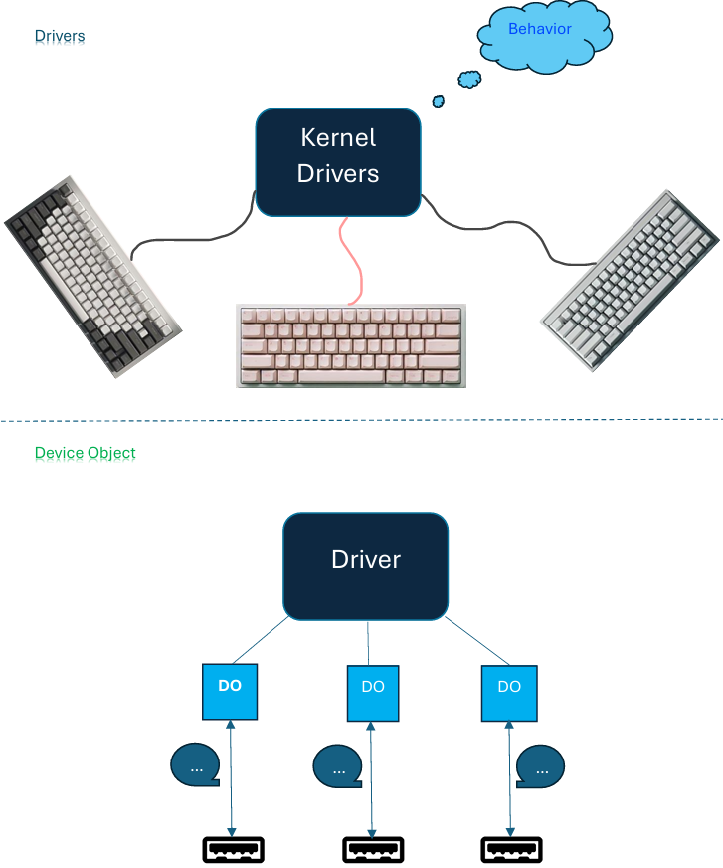
Device Object
Communication endpoints for clients.
Device Objects are instances of the DEVICE_OBJECT structure.
Can be layered

Slide 5



Tracing
WinDBG
Sysinternals
WinObj

Slide 6
Driver Example

Slide 7
Windows Driver Basics
Windows Driver Basics
Basic concepts about drivers in the Windows operating system.

